Slide 2
IWPA 2012 - 2013 Championships

Slide 3
IWPA Regional Hall of Fame
2012 – 2013 Season

Slide 4
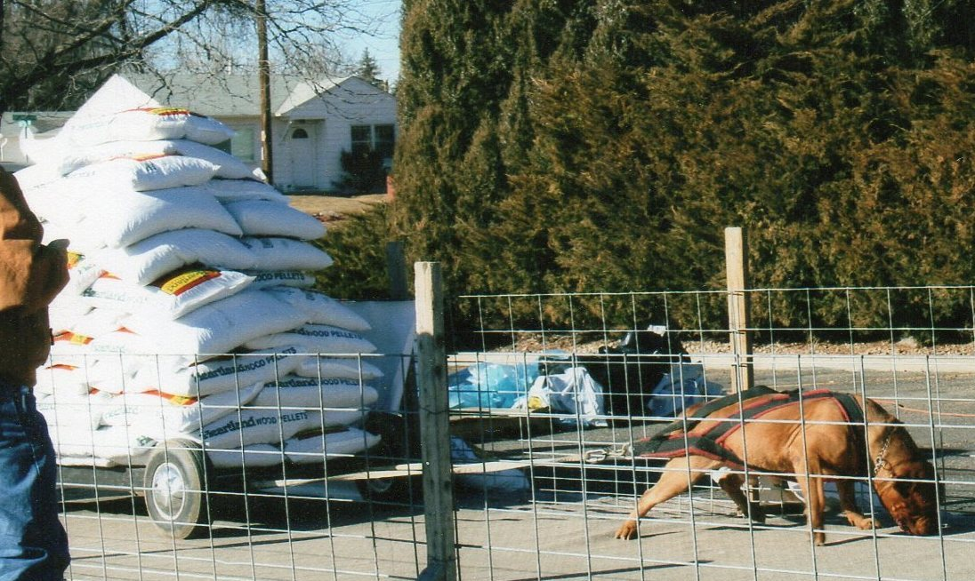
CH. Mount Sinai Dukes of Gold aka “King Dukes”
Owner/Handler:
Terry Reed

Slide 5
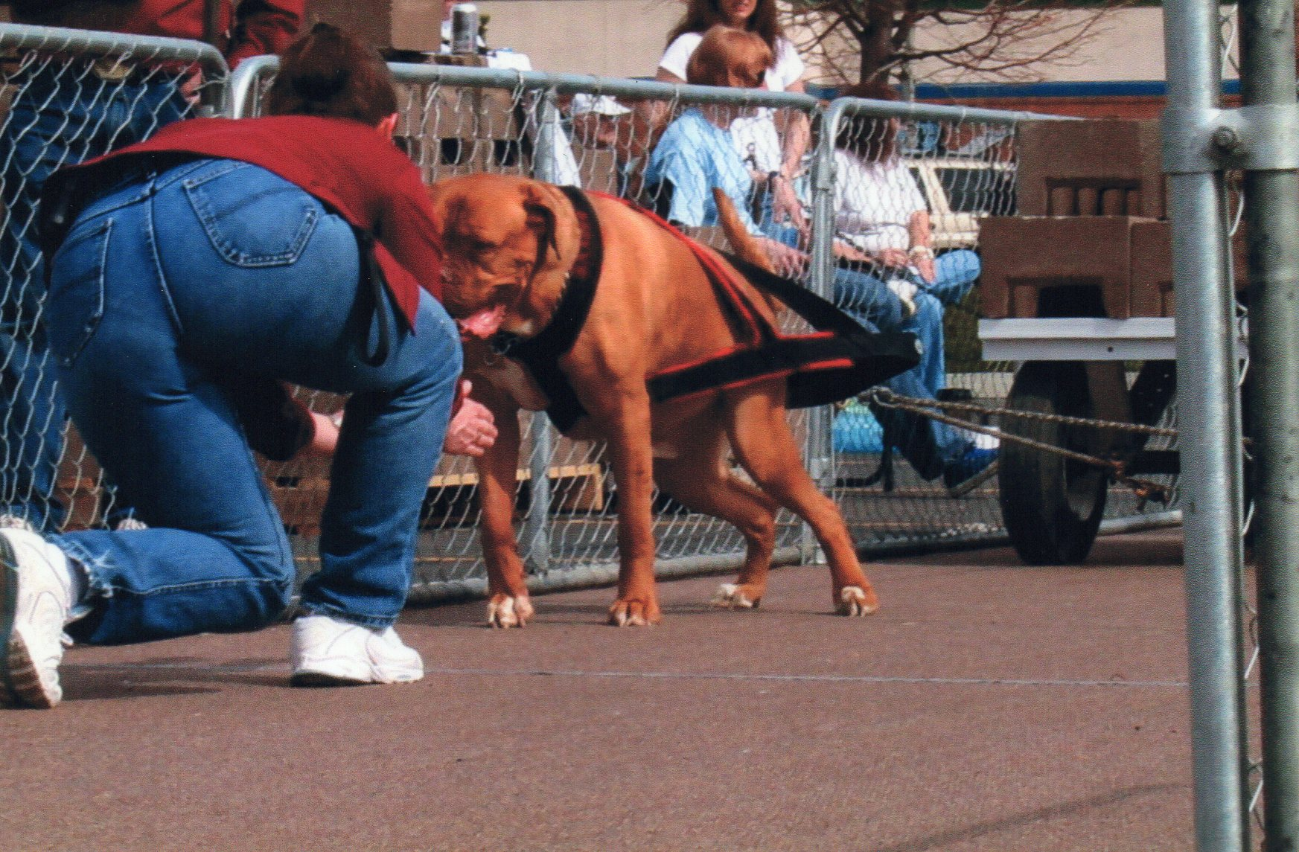
Royal’s Mischievous Baron Baxter aka “Baron Baxter”
Owner/Handler
Robbie Reed

Slide 6
Royal’s Valiant Duke Jonah aka “Duker”
Owner/Handler
Terry Reed

Slide 7
Blackstar’s Sir Tug of Snowline aka “Tug”
Owner/Handlers
Heather Jamison and Marshall Mummey

Slide 8
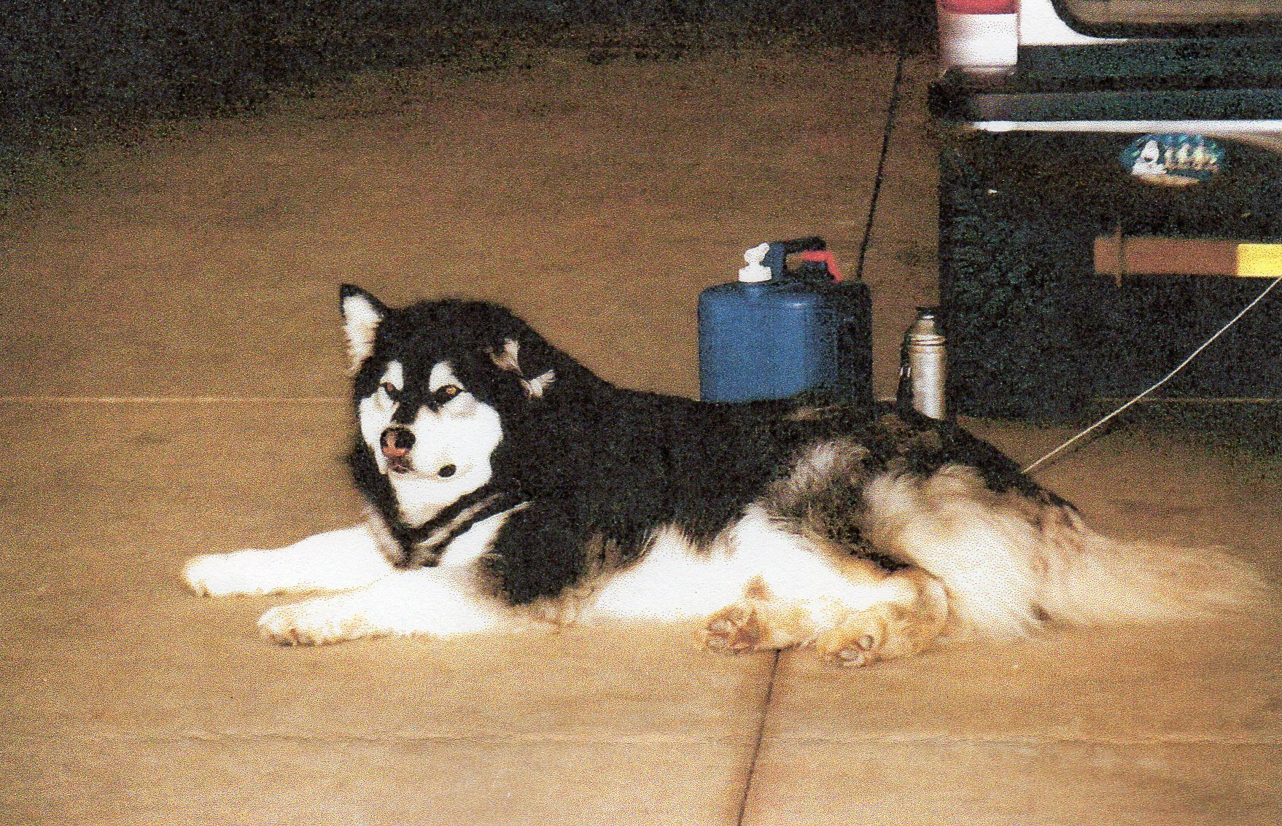
Big Thunder aka “Precious”
Owner/Handler
Sue Ferrari

Slide 9
Avalanche aka “Avi”
Owner/Handler
George Ferrari

Slide 10
Silver Wilbur aka “Silver”
Owner/Handler
Rodney Martin

Slide 11
Miss Rose Petal Martin
Owner/Handler
Cheryl Martin

Slide 12
Razzor Otis Martin
Owner/Handler
Cheryl Martin

Slide 13
The IWPA International Hall of Fame inductees will be discussed during the Board Meeting in June and will be announced in the August Pulling Power Newsletter
Congratulations to all Regional Hall of Fame recipients!!!

